Slide 1
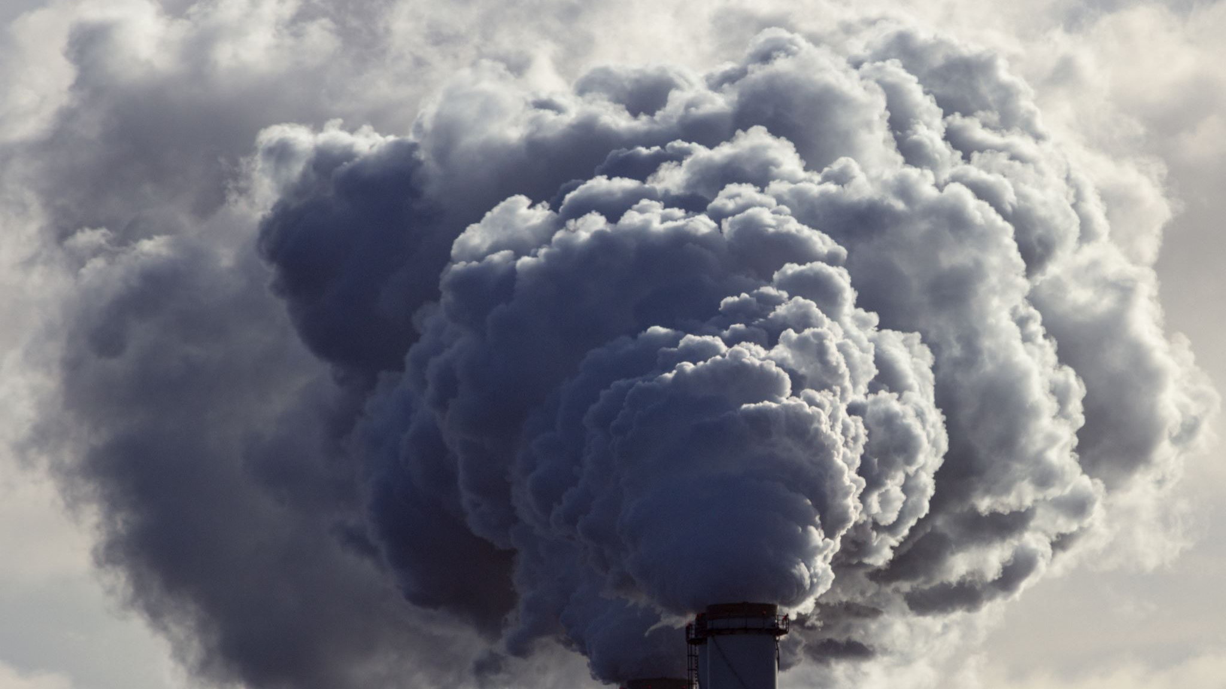
The ME-thane Infoboard – An ‘easy enough’-to-use platform for inspiring climate action on methane emissions
Team: TTTTTT
Eloise (Ellie) Ockenden (she/her), Tin Orešković (he/him), Fabian Reitzug (he/him),
Abram (Bram) Schönfeldt (he/him)

Slide 2
Problem (part 1): Raising awareness of climate impacts of methane
… this is the impact of the equivalent amount of methane
If this is the climate impact of CO² …
Fabian

Slide 3
Problem (part 2): Enabling evidence-driven mitigation strategies
Levers to mitigate emissions
Global
What can individuals do?
World
Endorse stricter regulation in energy production
Energy production and agriculture
Local Community
Energy distribution and waste management
Lobby for closing pipeline leaks
House-hold
Change from gas stove to induction
Diet and energy consumption
Local
Fabian

Slide 4

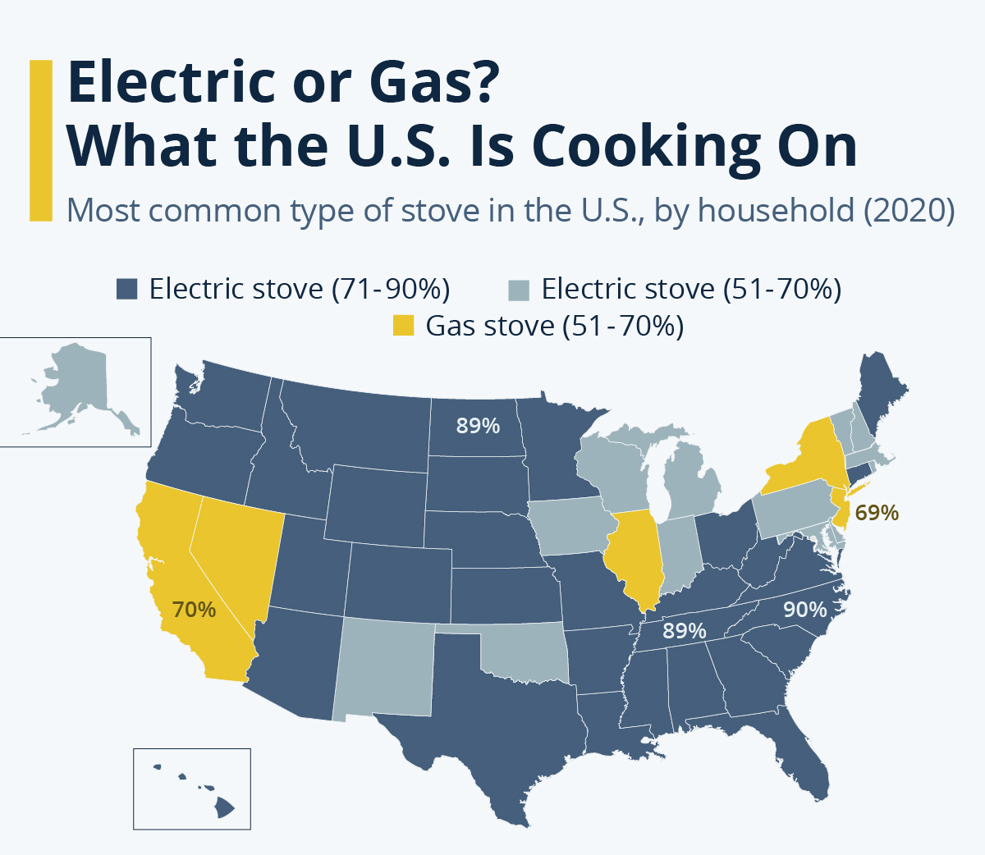




Methane has health impacts at different levels
Gas stoves
13% of childhood asthma in US attributable to gas stoves
How to minimise indoor pollution for all households?
Household
Pollution from leaks
Ozone due to gas flaring linked to respiratory disease and risk of explosions
How to prevent and address leaks?
Neighbourhood
Healthcare burden due to methane
Methane emissions lead to respiratory disease and impacts mental health
How to prepare the health care system?
Region

Slide 5
How can we act?

Slide 6
Our Vision: making action easy enough
Empowering individuals to take evidence-informed actions that protect the health and wellbeing of everyone
Bringing together people with different lived experiences to shape the direction of the platform’s development
Create momentum for collective action on methane regulation and policies that protect human health globally
Ellie

Slide 7



Data
Large-scale emissions
Household level emissions
Health impacts
Methane plumes
Methane emissions
Gas stove use
Respiratory disease
Mental health
Carbon Mapper Data Portal
Copernicus Climate Data Store
Simulated
CDC Wonder
SAMHSA
Ellie
Notes:
Name all the datasets
Explain how they’ve been cleaned (variable selection)
Mention that they are on different scales

Slide 8



Our approach: Making Action Easy Enough
Different motivations,
Lived experiences
Individual
Insights
Empowering action
Policy maker
Hospital administrator
Fabian

Slide 9






Our approach: stakeholders
Profile: individual who wants to live in healthy area
Profile: State-level politician representing diverse constituency
Profile: Hospital administrator who plans staffing
Why care? Methane leaks in neighbourhood are hazard
Why care? Gas stoves are potential health risk (with implications for health equity)
Why care? Cope with health burden of climate change
Need: Find out about methane leaks in area
Need: Understand health burden and current regulations
Need: Understand how climate change changes hospital burden
Action: Lobby for closing leaks
Action: Regulation of gas stoves
Action: Adequately staff for health burden
Fabian
Notes:
Explain the stakeholders
What do they want?
How will they interact with the platform?

Slide 10
DEMO

Slide 11


Communicating relationships in our platform
Tab
Healthier homes
Leaks in your area
Healthcare needs planner
ΩΩ
Level
Household
Neighbourhood
State
Spatial
Spatial
Spatial
Temporal
Dimension
Relationship
Gas stove use
Respiratory disease
Methane plumes
Lived experiences
Mental health
Methane
Respiratory disease
Ellie
Notes:
Focus on why this is innovative(?) – maybe separate by tab/story
Maps: showing data spatially such as methane plumes, showing health data spatially
Trends: showing trends in respiratory deaths/mental health morbidity, doing this by area informs
Chatbot for investigating the literature

Slide 12
Accessibility + usability of the platform
Interpretable visualisations
Interactivity and adaptability
Stakeholder stories
Accessibility
Usability
Clear explanations
Colourblind-friendly colour schemes
Three tabs for three purposes
Shared
Notes:
How would you ensure your platform is accessible, usable, and sustainable and that data can be shared safely and well credited?
Leads into feedback driven development (next slide)!
Accessibility
Overview page explains the purpose of each tab to the user.
Easy to interpret + clear plots
Use of colourblind-friendly colour schemes
Usability
Focus on stakeholders
Separation into three views to minimise clutter
Interactivity/adaptability

Slide 13
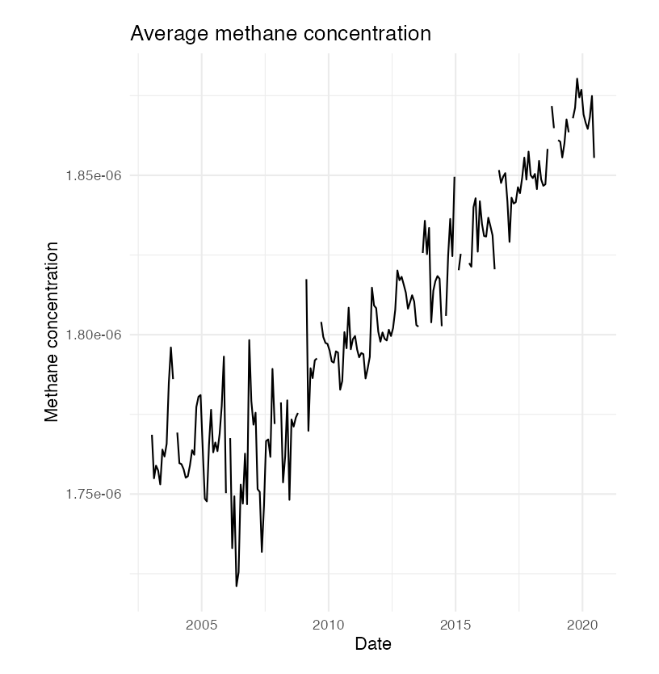
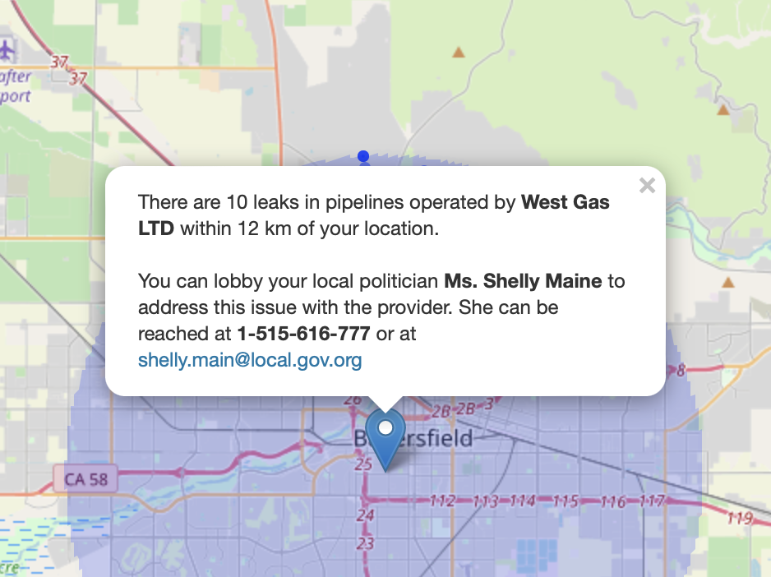
Feedback driven development
"I wonder why methane is increasing because it seems to be an across-the-board trend."
"As a first point in saying, 'Hey there are leakages in my area!', that's really amazing"… "If you are looking to make an appeal to a politician, you would probably like to know the company names."
Notes:
How would you ensure your platform is accessible, usable, and sustainable and that data can be shared safely and well credited?

Slide 14
Trustworthy data
Sustainability | Format | netCDF
Certification | Documentation | Datasheets for datasets
Safe-sharing | Anonymisation | Aggregation
Notes:
How would you ensure your platform is accessible, usable, and sustainable and that data can be shared safely and well credited?

Slide 15
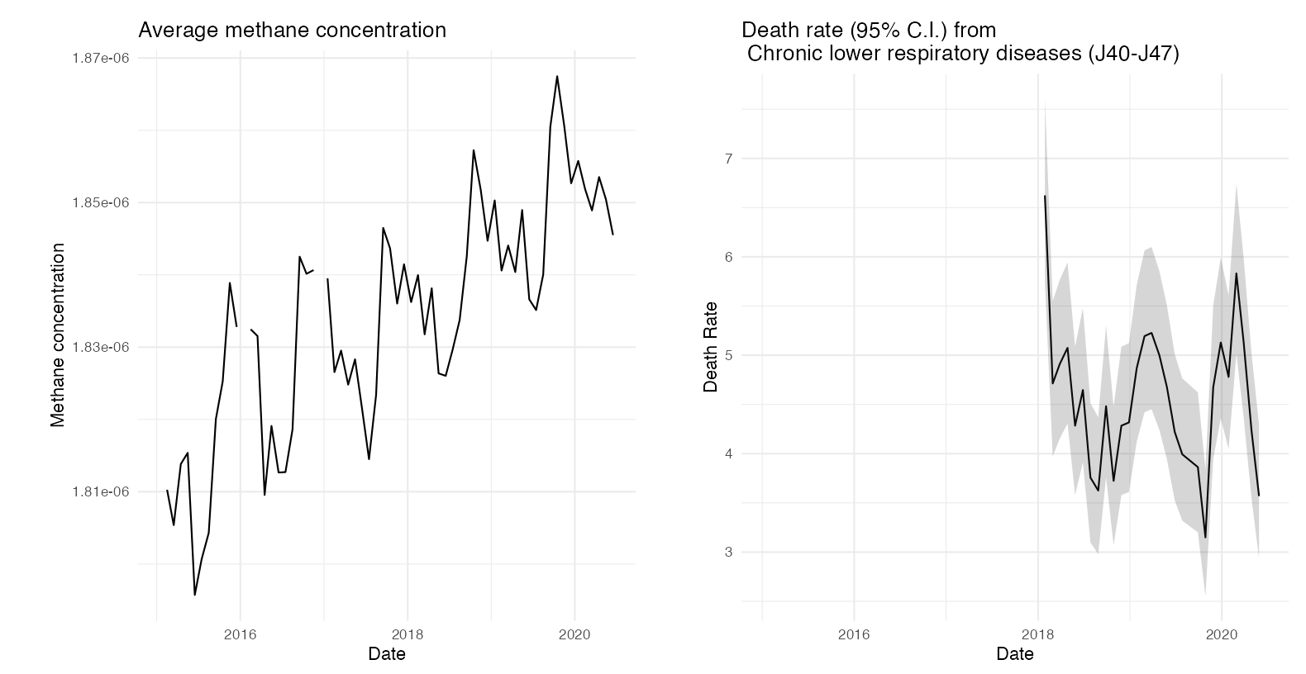
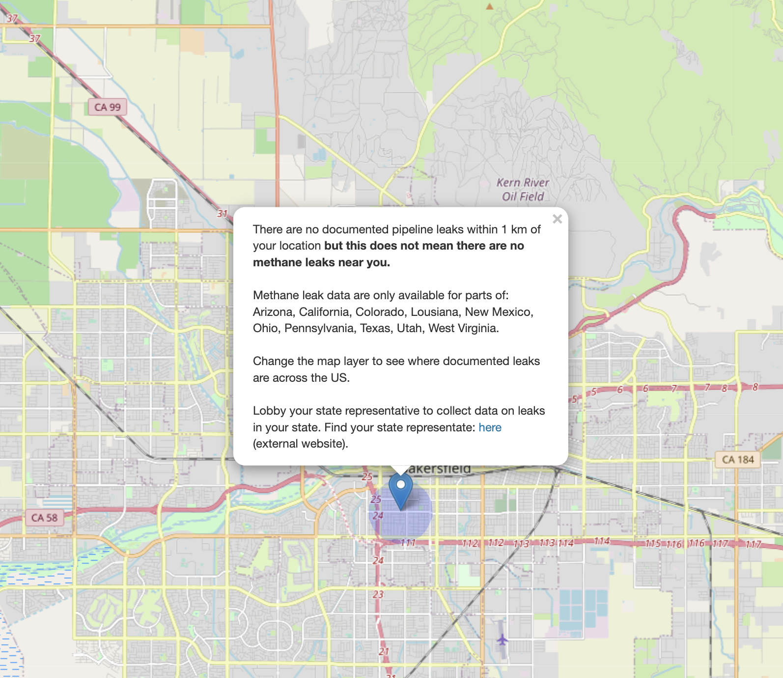
Dataset integration at different scales
Notes:
How will your platform integrate datasets with different time and geographical scales?
Make the spatial and temporal extents of data clear
Make where data is missing clear
Match up scales of different data-sets
Allow users to resample fine-grain data to coarser scales, but cannot do the inverse
Trendlines are meaningful over multiple granularities
Where relevant to the user, trends can be visualised over larger or smaller timescales
Choosing visualisations that work for each modality and presenting them in a non-hierarchical way

Slide 16
Future directions
Build on feedback from climate stakeholder
NLP driven semantic retrieval to pair relevant literature with data
Stronger integration of climate and health data in the spatial dimension

Slide 17
Conclusions
Created a dashboard that is relevant to stakeholders on all levels
Allowing an iterative process of development that incorporates stakeholder feedback
Facilitating all stakeholders to improve health through climate action

Slide 18
Appendices

Slide 19
Scales of data
Dataset | Information | Temporal extent | Temporal resolution | Spatial extent | Spatial resolution | Data format
Carbon Mapper Data Portal | Methane emissions | 2020-2021 | Not consistent | Unknown monitoring areas in several US States, each plume is | Not consistent | CSV, Raster
Copernicus Climate Data Store | Methane emissions | 2003-2016 | Monthly | Global | 500x500km, though with missing patches | Raster
CDC Wonder | Respiratory disease | 2018-2021 | Annual | USA | County-level | CSV
Yearly mental health data from SAMHSA | Mental health | 2020 | Annual | USA | State-level | CSV

